Slide 1
Facial Recognition Attendance System
Mifrah Zia
Bakhtawar Mirza
Abdullah Ahmad Arslan

Slide 2
Enhancing Campus Entry Efficiency with Facial Recognition
Problem Statement:
ID card scanning requires students to dismount vehicles, leading to traffic jams.
Fingerprint scanners for faculty are inconvenient, inaccurate, and prone to mismatching.
Key Benefits:
Efficiency: Eliminates stopping and manual card scans.
Accuracy: Avoids mismatches inherent in biometric/fingerprint systems.
Convenience: Fully automated and seamless.

Slide 3
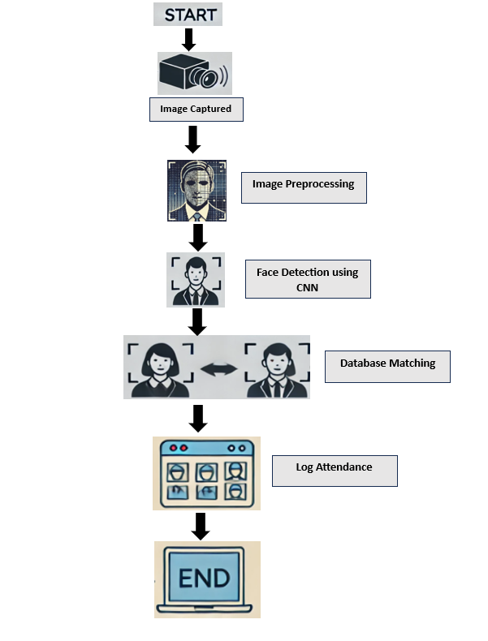
Facial Recognition Attendance System

Slide 4
Modules
OpenCV for capturing video frames, face detection and preprocessing tasks.
A pre-trained Convolutional Neural Network named Single Shot MultiBox Detector for detecting faces in real-time.
Custom preprocessing and embedding techniques for comparing and matching faces.
A Flask APIs for marking attendance in the database.

Slide 5
Face Detection
Pass the frame to the pre-trained model after applying some required things by the DNN.
Confidence Threshold: Only faces with a confidence score above 0.7 are considered valid.
Extract bounding boxes for detected faces based on confidence score.
Detected faces are cropped and passed through a preprocessing and embedding generation process pipeline.
A recently_marked cache prevents marking the same student multiple times within a short time window along with necessary checks to prevent duplication.

Slide 6
Image Recognition
Extracting face embedding using ResNet-50:
Uses a pretrained ResNet-50 model from PyTorch’s torchvision.
The last fully connected layer is removed to get feature embeddings instead of predictions.
Preprocesses Images:
Images are resized to 224x224 (standard for ResNet).
Images are converted to tensors and normalized using ResNet-specific values:
Mean: [0.485, 0.456, 0.406]
Std: [0.229, 0.224, 0.225]
Converts Images into Embeddings:
The model generates a feature vector (embedding) for each face image.
The result is returned as a NumPy array.

Slide 7
ResNet-50
A deep convolutional neural network with 50 layers.
Pretrained Model: Trained on ImageNet for general image recognition tasks.
Focus: Extracts high-level features or embeddings from images (size 2048).
Efficiency:
50 layers offer a good balance between depth and computation, making it more efficient than deeper models like ResNet-101.
High-Quality Embeddings:
Extracts detailed features useful for tasks like face recognition and image retrieval.
Converts images into a compact vector representation (2048-dimensional).

Slide 8
Why use ResNet-50
ResNet-50
ArcFace
Provides feature embeddings for face recognition.
High accuracy in image recognition tasks.
Transfer learning capabilities with pre-trained models.
Efficient for face recognition with less computational load.
Highly optimized for face recognition with discriminative embeddings.
Computationally expensive compared to ResNet-50.
ResNet-50 is a lighter option when resources are limited.
MTCNN
RetinaFace
Primarily for face detection.
Good at handling varied angles and lighting.
Does not provide embeddings for recognition.
Specialized in face detection, even in challenging conditions.
Requires another model (like ResNet-50) for face recognition.

Slide 9
Marking Attendance in Database
Database Class Overview:
Purpose:
Manages student data in a PostgreSQL database.
Functionality:
Connects to the database.
Creates a table to store student information (name, ID, gender, department, image, embedding).
Inserts student records into the table.

Slide 10
Marking Attendance in Database
Key Methods in Database Class:
create_table():
Creates the students table if it doesn't exist.
Columns: id, name, student_id, gender, department, image, embedding.
insert_student():
Inserts a student’s data (name, ID, gender, department, image, embedding).
Embedding is converted from a numpy array to a Python list for storage.
close():
Closes the database connection and cursor.

Slide 11
Why use Websockets?
A communication protocol that allows real-time, two-way interaction between a client and a server.
Usage in Attendance System:
WebSockets enable the real-time transmission of student attendance data between the face recognition system and the database.
When a student’s face is recognized, their data (name, student ID, etc.) can be immediately sent to the database for storage or update without needing to refresh the page.

Slide 12
Challenges and Solutions
Challenges Faced:
Low Camera Quality: The laptop camera (0.9 MP) produced low-resolution images, affecting accuracy.
Image Quality: Poor quality led to blurry or unclear images, reducing the model's ability to recognize faces accurately.
Similarities Between Images: Faced challenges with similar-looking faces, especially in low-quality images, making identification difficult.
Solutions Implemented:
Image Preprocessing: Contrast enhancement to improve image clarity.
Embedding Extraction: Utilized ResNet-50 for extracting feature embeddings, which improved face recognition accuracy even with low-quality images.

